Slide 1
Online Pharmacy Web App
Linnet Tuscano
Vansh Rahate
Vishv Kaneria
Yashwanth Deshini

Slide 2
Content
Jira burndown charts
Add your third bullet point here

Slide 3
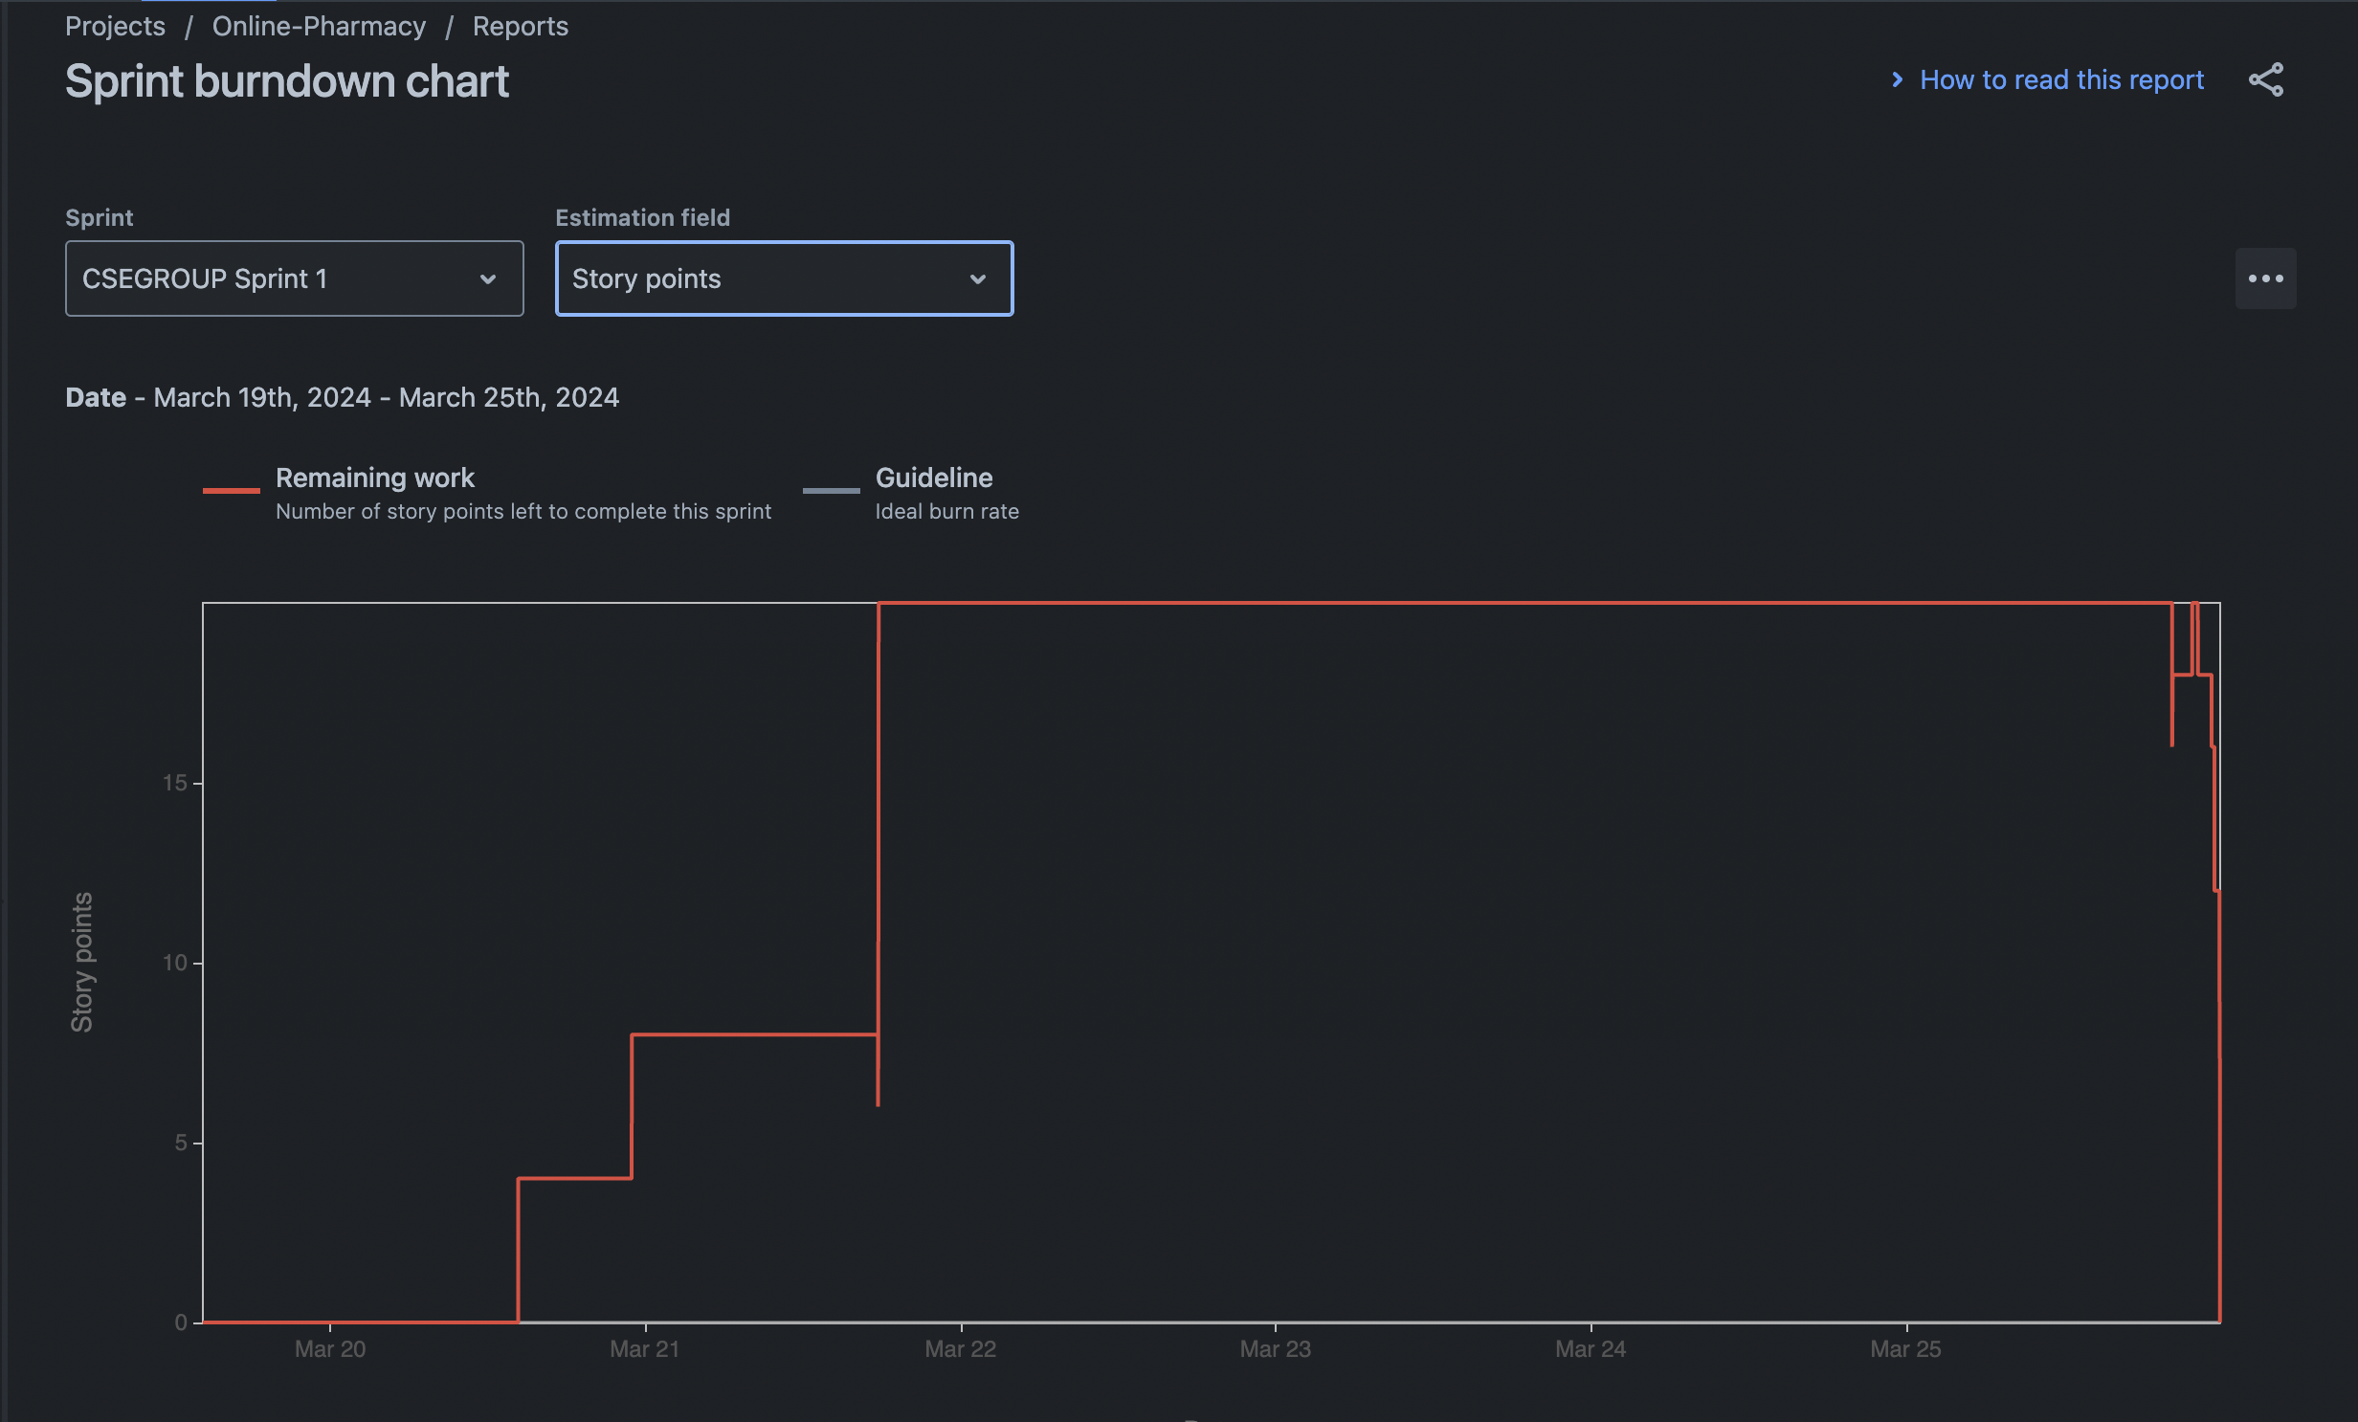
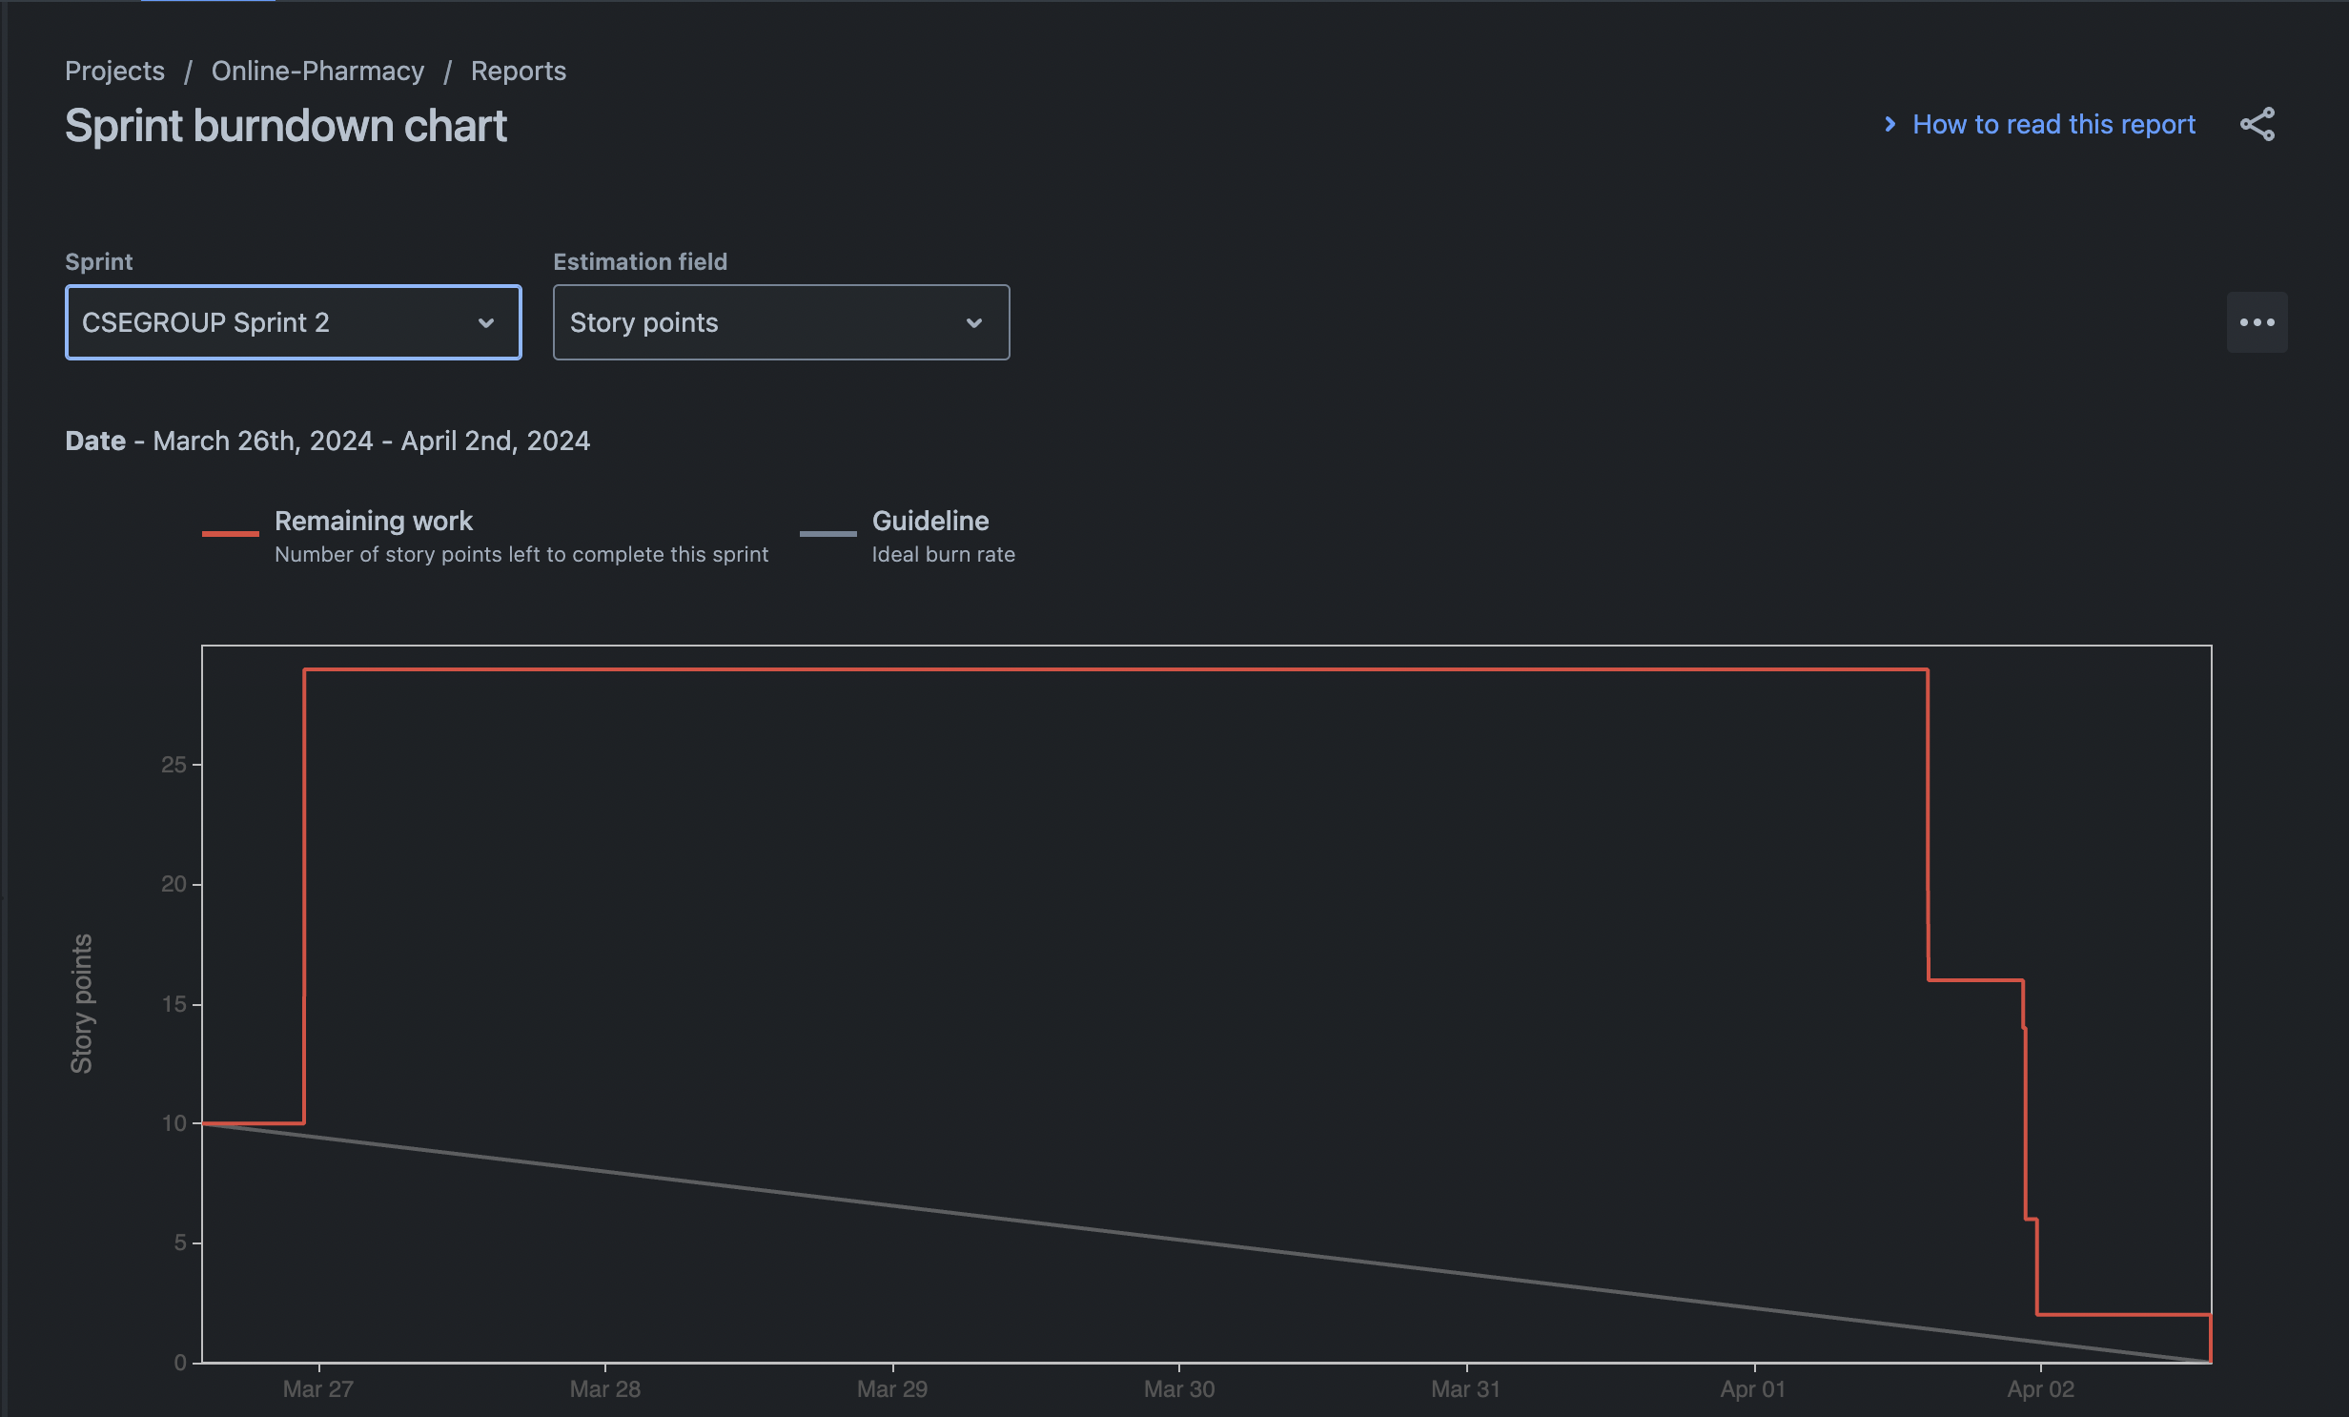
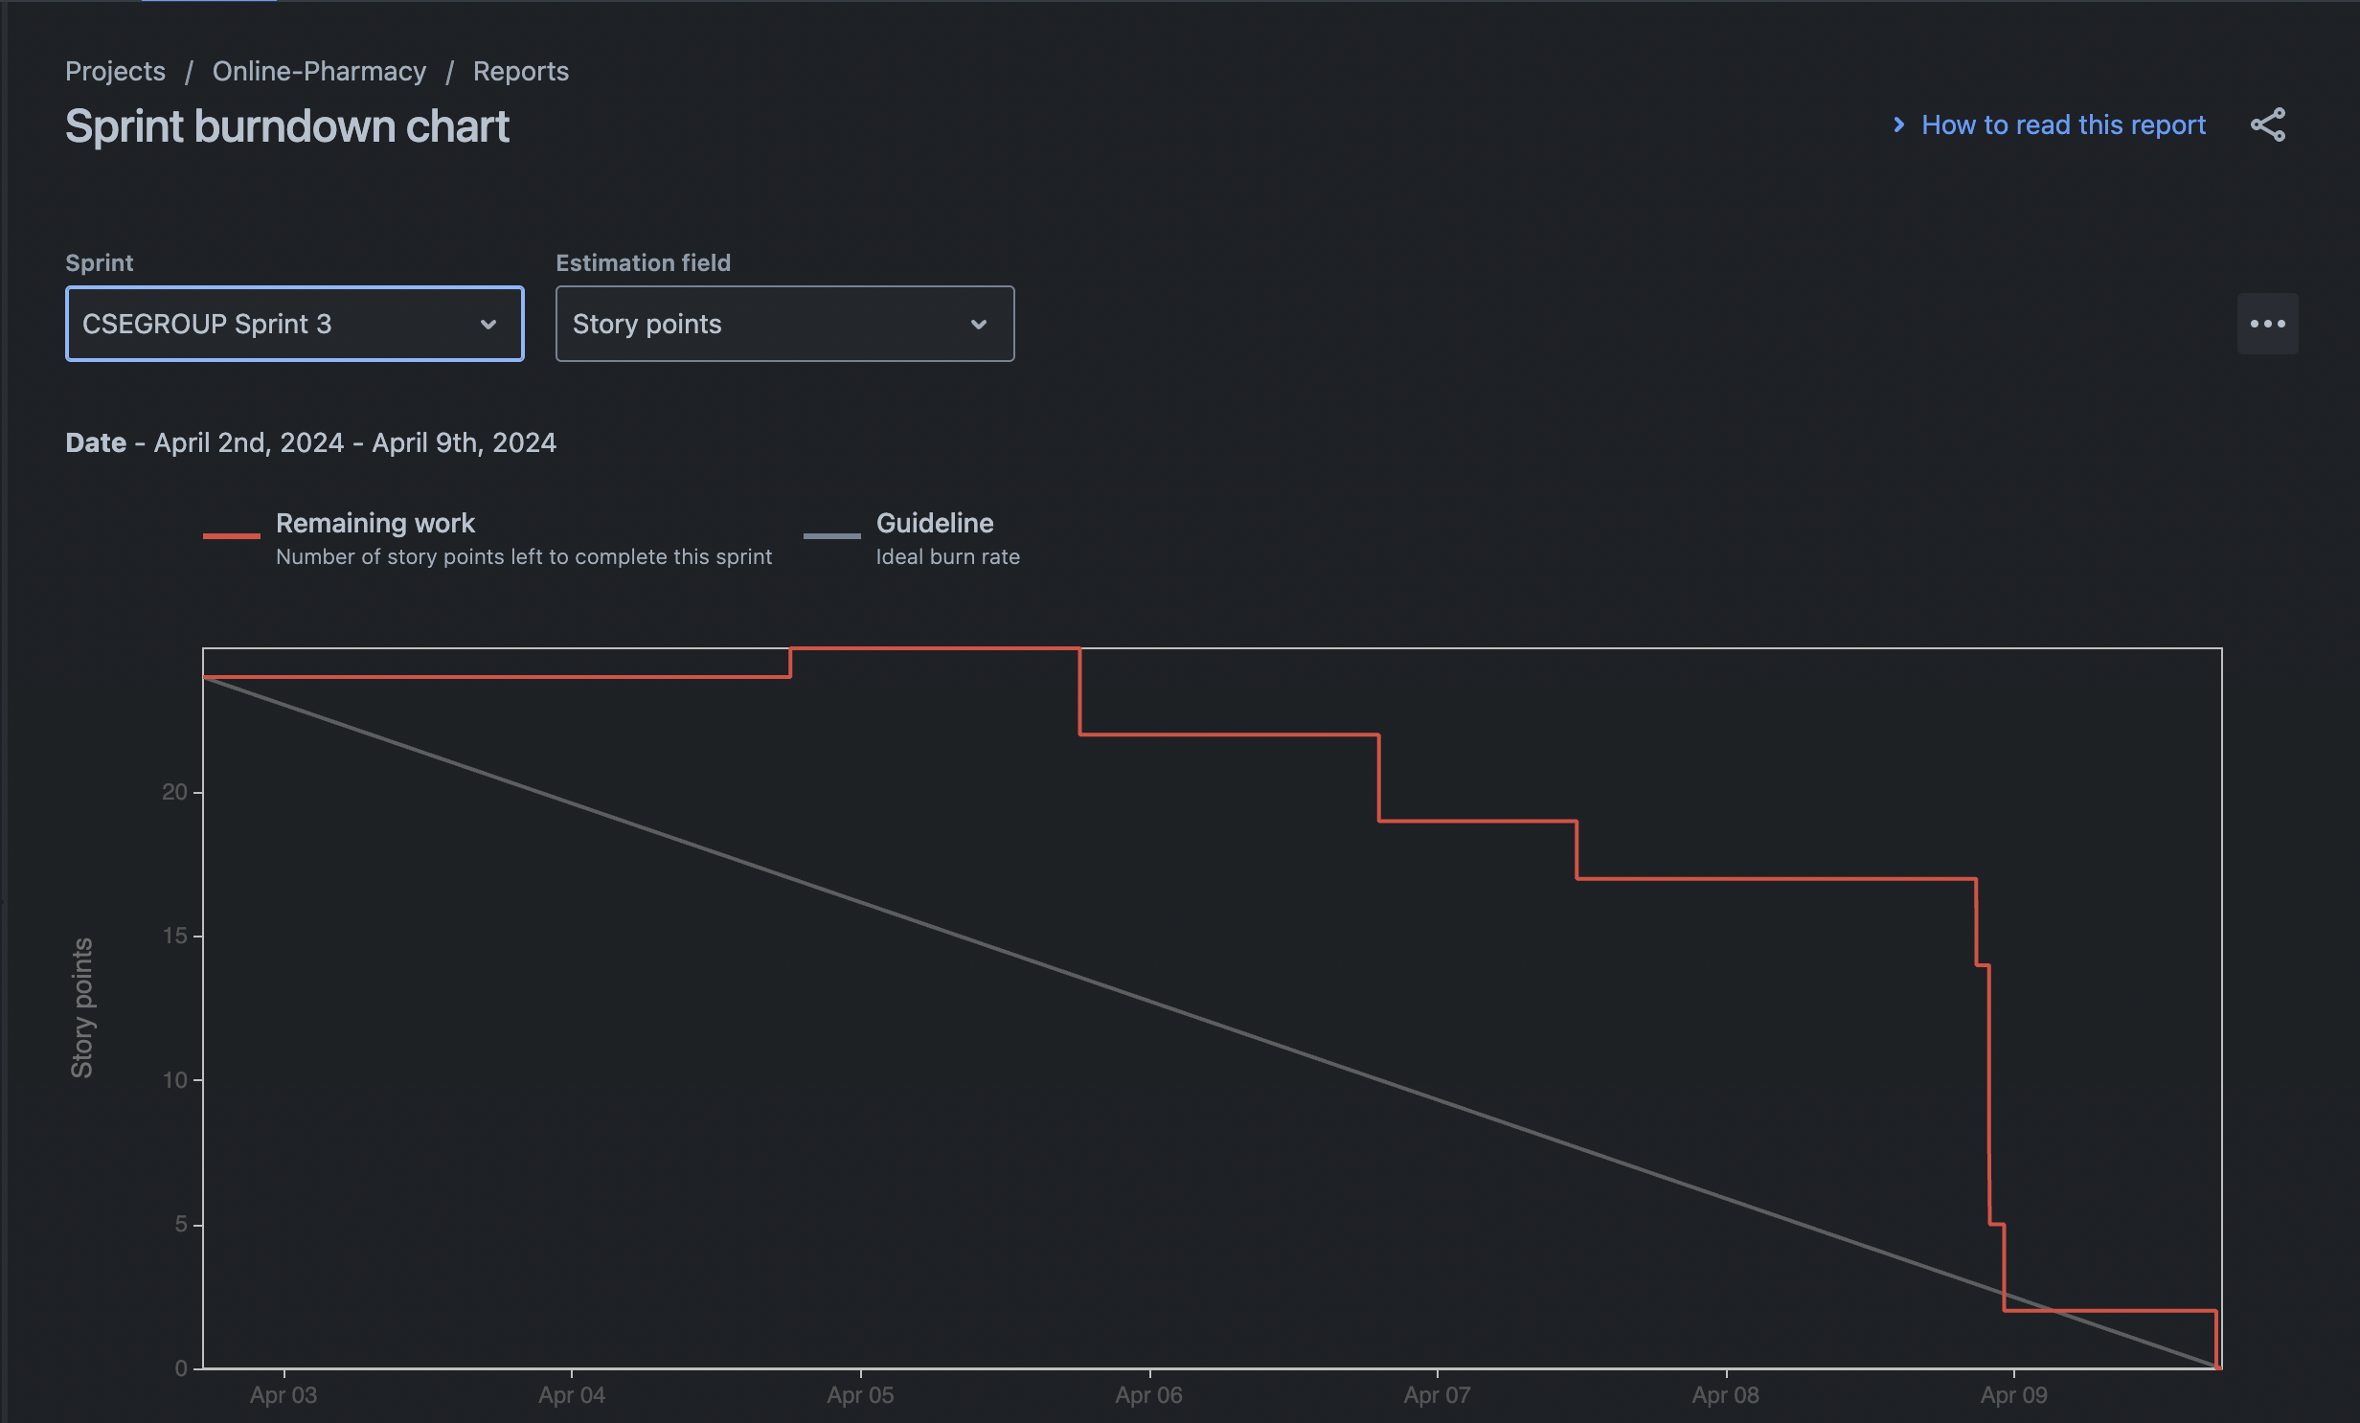
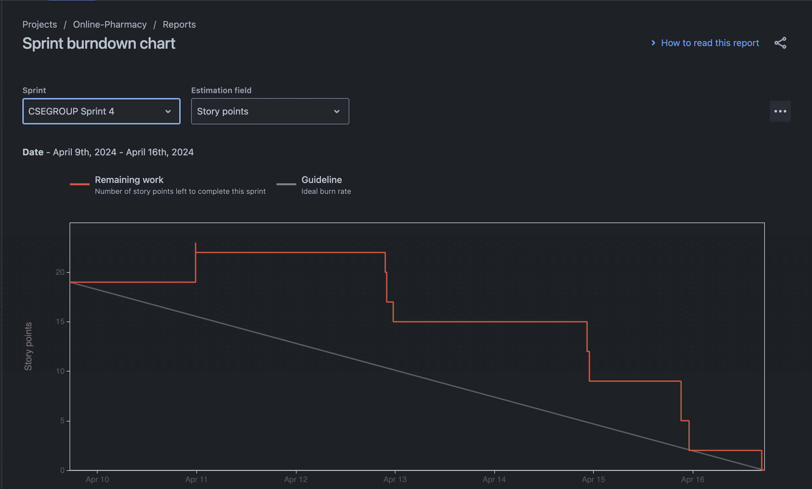
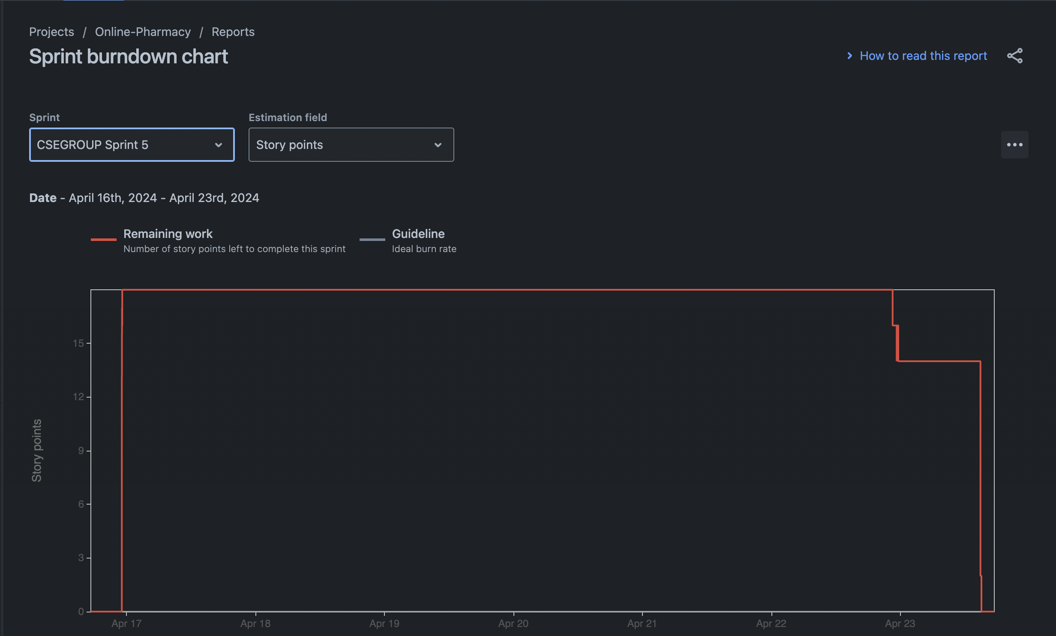
Jira burndown charts

Slide 5
Group A
Task 1
Task 2
Group B
Task 1
Task 2
Group C
Task 1

